Slide 1
Test Plan and Test Cases

Slide 2
Version Control and Revision History
 | Name | Date
Prepared By | Sneha Kumar | 07-Mar-2019
Reviewed By | Manisha Mane | 07-Mar-2019
Approved By | Nisha Mendonsa | 07-Mar-2019
Version No. | Date | Section Affected | Highlight of Changes
1.0.0 | 07-Mar-2019 | All | Original Version.

Slide 3
TEST PLAN-Intro
A software project test plan is a document that describes the objectives, scope, approach, and focus of a software testing effort.
The process of preparing a test plan is a useful way to think through the efforts needed to validate the acceptability of a software product.
It identifies test items, the features to be tested, the testing tasks, who will do each task, and any risks requiring contingency Planning.

Slide 4
References for preparing Test Plan
The supporting documents for referring the test plan are:
Project Plan
System Requirements specifications.
High Level design document.
Detail design document.
Development and Test process standards.
Methodology

Slide 5
Test Plan Template
Introduction
Brief introduction of the test strategies, process, workflow and methodologies used for the project
Test scope
In Scope
Scope defines the features, functional or non-functional requirements of the software that will be tested
Out of Scope
Out Of Scope defines the features, functional or non-functional requirements of the software that will NOT be tested

Slide 6
Approach
It gives the overall Testing Approach.
It describes the following details
Are any special tools to be used and what are they?
Will the tool require special training?
What metrics will be collected?
Which level is each metric to be collected at?
How is Configuration Management to be handled?
How many different configurations will be tested?
Hardware
Software
Combinations of HW, SW and other vendor packages

Slide 7
What levels of regression testing will be done and how much at each test level?
Will regression testing be based on severity of defects detected?
How will elements in the requirements and design that do not make sense or are untestable be processed?
Entry & Exit Criteria
Here the test plan should explain as when the testing needs to be started (Entry Criteria) and when the test should be stopped (Exit Criteria)
The idea behind this section is that every process step be inspection, and functional test or Design has a precise entry & exit criteria

Slide 8
Suspension & Resumption Criteria
Suspension criteria specify the criteria to be used to suspend all or a portion of the testing activities
Resumption criteria specifies when testing can resume after it has been suspended.

Slide 9
Example
SUSPENSION CRITERIA | RESUMPTION CRITERIA
Urgent defects, which prevent further testing along any path. | Urgent defects are rectified
Non availability of Test data for scenarios | Test data uploaded in test environment as required to execute scenarios/cases

Slide 10
Test Deliverables
You have to define the list of deliverables which will be delivered from the testing engagement
For example
Test Plan
Traceability Matrix
Test Cases
Test Execution Log
QA Cycle Status Report

Slide 11
Environment Plan
Hardware configuration
For example as mentioned below, this should be the environment which the testers will be performing the test.
This is a very critical section which is an agreement and defining the environment where the testing will be performed
Laptops (Dell) Win XP & Win 2K IE 6.0- Novel Client
Cognizant Desktop compatible to Schering GX260 Win XP IE 6.0
Software Configuration
Home Office Image
Research Image
Active X Control.
Note:
The above mentioned lists are the builds or setup which needs to be deployed in the testers system prior to testing.
If this is not satisfied then the entire test performed by the testers will become invalid

Slide 12
Staffing and Training Needs
Training on the application/system.
Training for any test tools to be used.
The Test Items and Responsibilities sections affect this section. What is to be tested and who is
responsible for the testing and training.

Slide 13
Test Schedule
Specify test milestones
Specify all item transmittal events
Estimate time required to do each testing task
Schedule all testing tasks and test milestones
For each testing resource, specify its periods of use

Slide 14
Risks and Mitigation Plan
Risk detail should be given in the test plan, based on the category of the risks the impact will be applied
What are the overall risks to the project with an emphasis on the testing process?

Slide 15
Example:
Lack of personnel resources when testing is to begin.
Lack of availability of required hardware, software, data or tools.
Late delivery of the software, hardware or tools.
Delays in training on the application and/or tools.
Changes to the original requirements or designs.
Complexities involved in testing the applications

Slide 16
Roles & Responsibility
Identify groups responsible for managing, designing, preparing, executing, witnessing, checking and resolving.
Identify groups responsible for providing the test items identified in the Test Items section.
Identify groups responsible for providing the environmental needs identified in the Environmental Needs section

Slide 17
Reference to Templates
This section should give reference to the templates for the following
Test cases
Review check list for Test cases
Test Incident Report
Test Summary Report

Slide 18
Test Scenario
A Scenario is any functionality that can be tested. It is also called Test Condition or Test Possibility.
A scenario is an idea from which we can derive possible test cases on particular functionality.

Slide 19
Test Case
It is a document which identifies the various tests required to ensure that the system covers all the requirements for the customer.
A case that tests the functionality of specific object
Test case is a description of what to be tested, what data to be given and what actions to be done to check the actual result against the expected result.
It is document which includes step description of i/p, o/p conditions with test data along with expected results.
Test cases follow agreed standard format.(This will be based on the agreed upon format specified in the QAP or as specified in the Standards and Guidelines document)

Slide 20
Test Case Design
Test cases are designed to ensure complete coverage of the software components under different environmental conditions and data inputs
Test cases should exist for checking Performance of various operations e.g. data retrieval and updation, report printing
Test cases should exist for covering error conditions that can occur
Test data should be mentioned explicitly for each test condition

Slide 21
Characteristics of good test cases
A good test case should have the following:
TC should start with “what you are testing”.
TC should be independent.
TC should not contain “If” statements.
TC should be uniform.

Slide 22
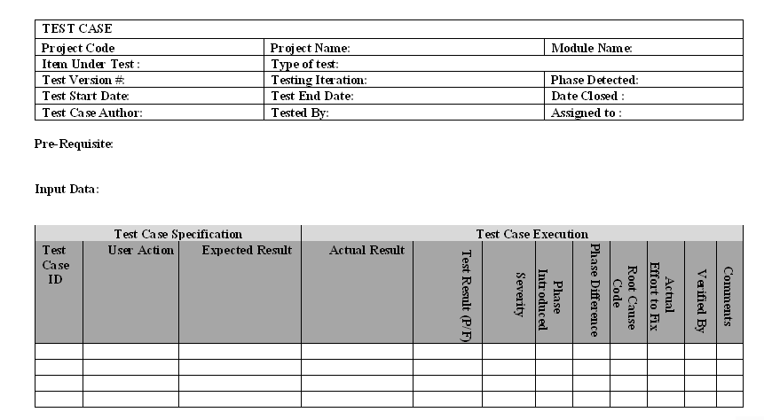
Test Case Template (Standard )

Slide 23
Test Case Reviews
Self-review: It is done by the tester himself who has written the test cases. He can verify whether all the requirements are covered or not by looking into SRS/FRD.
Peer review: It is done by another tester who hasn’t written those test cases but is familiar with the system under test. Also known as Maker and Checker review.
Review by a supervisor: It is done by a team lead or manager who is superior to the tester who has written the test cases and has great knowledge about the requirements and system under test.

Slide 24
Some of the common mistakes which are check during the test case review process are:
Spelling mistakes: Sometimes, spelling mistake can create a lot of confusions or make a sentence difficult to understand.
Grammar: If grammar is not proper then test case can be interpreted in a wrong way, resulting in wrong results.
Template format: If proper template is followed then it becomes easy to add/modify test cases in future and test case plan looks organized.
Standard/Guidelines: While review process, it is very important to check whether all the standards and guideline are properly followed.
Language used: Test cases should have a very simple language which is easy to understand.
Functionality coverage: It is highly recommended that all the functionality associated with the system under test should be covered so that major defects are not missed.
Replication: It refers to the duplicate test cases removal. It is possible that two or more test cases test the same thing and can be merged into one, this would save time and space.
Redundancy: It refers to uselessness of a test case due to change in requirements or some modifications. Such test cases must be removed.

Slide 25
Defect Tracking/Closure
Defect Identified by the Tester
Entry made in the DTS Web by Tester
DTS Web can be accessed by Developers/Testers
Summary of the Defect and Description are entered
Severity is chosen among Fatal/Major/Minor/Suggestion
Priority could be High/Medium/Low
The initial State will be Open

Slide 26
Defect Tracking (Contd...)
Defect Analyzer - Analyses the impact of the Defect
Assigns to the concerned team with person responsible
DA - Informs the concerned person
Further Comments can be given in the Description
DA enters the Phase introduced, detected and Root Cause Codes

Slide 27
Defect Tracking (Contd...)
Assigned team member fixes the defect
On resolution DA changes the defect to Under QC
QC reviews and tests the impacted items
If review ok the defect state is changed to Fixed
Changed files are checked-in to the VSS by CC
If review failed, its again assigned to the concerned team
DA informs the initiator to check for closure of the defect
Initiator confirms the Defect is actually fixed for Closure

Slide 28
Defect Tracking (Contd...)
Defect Analyzer - Analyses the impact of the Defect
Assigns to the concerned team with person responsible
DA - Informs the concerned person
Further Comments can be given in the Description
DA enters the Phase introduced, detected and Root Cause Codes

Slide 29
Defect Tracking (Contd...)
Assigned team member fixes the defect
On resolution DA changes the defect to Under QC
QC reviews and tests the impacted items
If review ok the defect state is changed to Fixed
Changed files are checked-in to the VSS by CC
If review failed, its again assigned to the concerned team
DA informs the initiator to check for closure of the defect
Initiator confirms the Defect is actually fixed for Closure

Slide 30
Queries

Slide 31
Thank You.

